Slide 1

facebook
Developing Facebook Application
A basic introduction

Slide 2

Who we are
Abhishek Deshpande
MBA Student
Follow @Fitehal
Abhishek@whoisabhi.com
Chetan Gole
MCA Student
Follow @_techie
me@thechetan.com

Slide 3
What is Facebook
More than 400 million active users on Facebook
People spend over 500 billion minutes per month on Facebook
over 160 million objects(pages, groups and events) that people interact
More than 70 translations
30% of Facebook users are from United States
Ref : http://www.facebook.com/press/info.php?statistics

Slide 4
Why Facebook App.
Bring Existing App to FB World
Campaigning on FB
Building a Brand

Slide 5
Top Facebook Apps
Name Developer
1. FarmVille Zynga
2. Static FBML Facebook
3. Facebook for iPhone Facebook
4. Birthday Cards RockYou!
5. Texas HoldEm Poker Zynga
6. Café World Zynga
7. Causes Causes
8. Mafia Wars Zynga
9. PetVille Zynga
10. Mobile Facebook

Slide 6
What happens when you access Facebook App

Slide 7
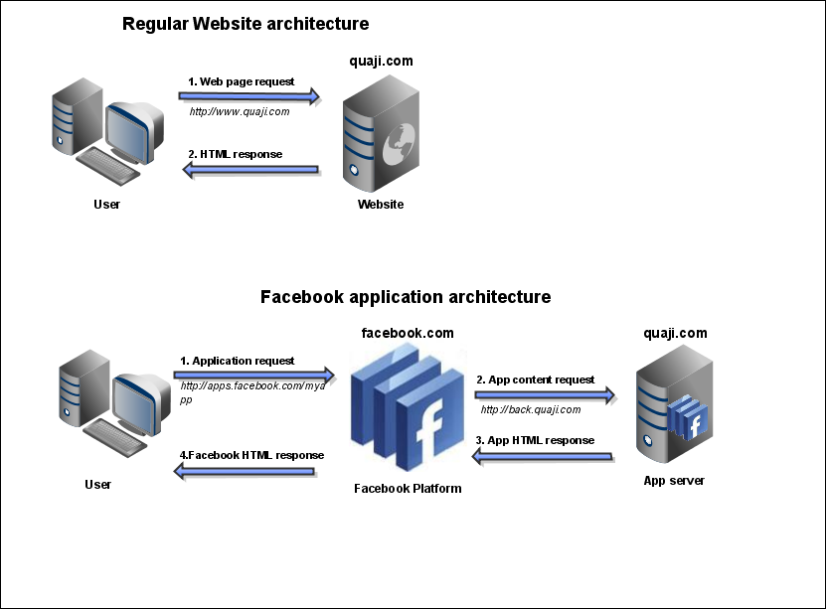
What happens when you access Facebook App
Image Credit : http://www.zilby.com/images/arch.png

Slide 8
Facebook Platform
FBML / XFBML -Tag based markup language derived from HTML / XML, with some extra Power to play with FB
FQL - Facebook query language - Ideal for querying extra data from Facebook Internal data tables.
FBJS - Facebook version of Javascript minimizing threats of Cross scripting attacks. Supports Most of DOM - Based manipulation Methods

Slide 9
Facebook API
Facebook API calls are grouped into various action categories, each focuses on different aspect of platform.
Let us look at some basic ones :
facebook.auth - basic authentication checks for facebook users
facebook.feed - Post to facebook news feed
facebook.friends - query fb for various checks on a user's friends
facebook.notification - send messages to users
facebook.profile - set FBML in user's profile
facebook.events - way to access FB events
facebook.groups - access information for facebook groups
facebook.photos - interact with facebook photos

Slide 10
Client Libraries
PHP
- Easy to use
- Officially Supported
- Wide options for Hosting
Also Libraries are Available for Python, Ruby, .NET, Java & C++

Slide 11
FBML
Facebook markup language derived from HTML / XML.
To distinguish between HTML and FBML in app code, you need to prefix fb: to FBML tags
More than 100 tags to play with.

Slide 12
<fb:name uid="1431430963" /> => you
<fb:name uid="1431430963" capitalize="true" /> => You
<fb:name uid="1431430963" possessive="true" /> => Your
<fb:name uid="1431430963" reflexive="true" /> => Yourself
<fb:name uid="1431430963" useyou="false" /> => Abhishek Deshpande
<fb:name uid="672981152" /> => Chetan Gole
<fb:name uid="672981152" firstnameonly="true" /> => Chetan

Slide 13
Add Bookmark
<fb:bookmark />

Slide 14
Shows Dialog
<fb:dialog id="simple-dialog">
<fb:dialog-title>simple Dialog</fb:dialog-title>
<fb:dialog-content> This is some garbage content to be displayed. </fb:dialog-content>
<fb:dialog-button type="button" value="Okay!" close_dialog="1" />
</fb:dialog>
<a href="" clicktoshowdialog="simple-dialog">show Dialog</a>

Slide 15
FQL
Same syntax as ANSI-SQL
No implementation for Limit, Group by, Order By Clauses

Slide 16
User Table
uid, first_name , middle_name, last_name, name , pic_small , pic_big, pic_square, pic, affiliations, profile_update_time ,timezone ,religion ,birthday ,birthday_date ,sex ,hometown_location , meeting_sex , meeting_for , relationship_status , significant_other_id , political , current_location , activities, interests ,is_app_user , music , tv , movies , books , quotes ,about_me, hs_info , education_history , work_history ,notes_count , wall_count , status , has_added_app , online_presence , locale , proxied_email , profile_url , email_hashes , pic_small_with_logo , pic_big_with_logo , pic_square_with_logo , pic_with_logo , allowed_restrictions , verified , profile_blurb , family , username , website , is_blocked , contact_email , email

Slide 17
$fql = "Select name, pic FROM user where uid='100000860190302'";
$fql_result=$facebook->api_client->fql_query($fql);
print_r($fql_result);
Array (
[name] => Pranay Patil
[pic] =>
http://profile.ak.fbcdn.net/hprofile-ak-sf2p/hs624.snc3/27399_100000860190302_8058_s.jpg
)

Slide 18
Functions (FQL)
now() Returns the current time.
rand() Generates a random number.
strlen(string) Returns the length of the string.
concat(string, ...) Concatenates the given strings (can take any number of strings).

Slide 19
More Functions (FQL)
substr(string, start, length) Gets a substring of the string.
strpos(haystack, needle) Returns the position of needle in haystack, or -1 if it is not found.
lower(string) Converts the string to lower case.
upper(string) Converts the string to upper case.
strip_tags(field) Strips HTML markup and encoding from a specified FQL field.

Slide 20
FBJS
<script> Tag is allowed
Javascript/DOM "id" values are rewritten on-the-fly
<a href="#" onclick="new Dialog().showMessage('Dialog', 'Hello World.'); return false;"> Display Dialog.</a>

Slide 21
Developer resources
Test Console http://developers.facebook.com/tools.php
Developer Application http://www.facebook.com/developers/
Developer Wiki http://wiki.developers.facebook.com

Slide 22
if (questions)
{
for Q in questions:
answer(Q)
} else
{
print "Thank you!"
}

